Slide 1
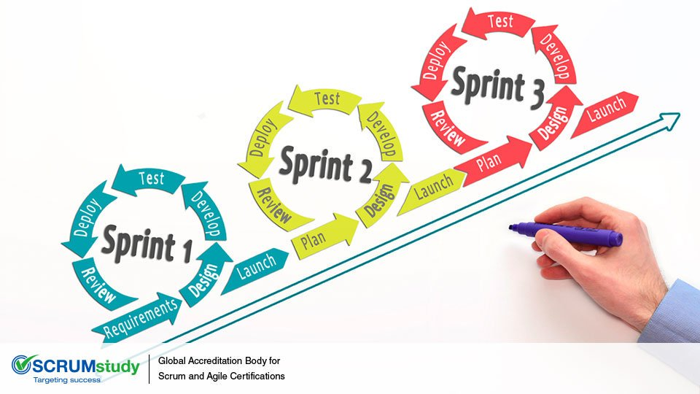
Task 8.1G – SIT223
https://www.google.com/url?sa=i&url=http%3A%2F%2Fblog.scrumstudy.com%2Fsprint-changes-additions-to-a-sprint-in-progress%2F&psig=AOvVaw2_PvcWx0yKjNq2D1KOrPL0&ust=1599360223263000&source=images&cd=vfe&ved=0CAIQjRxqFwoTCJCQrqL_0OsCFQAAAAAdAAAAABAK

Slide 2

Overview of Group activities
Collaborative/meetings – Time line:
27/8 – Meeting One
2/9 – Meeting Two
5/9 – Meeting Three
5/9 – Meeting Four
Discussed roles for the task and planned the first sprint.
Cam: Support/Contact page.
Secure Registration Portal
Syed: Inquiry/Submission.
Caitlyn: Login Feature
Kyria: Login Feature
Vehicle Form
Assigned Ownership Roles:
Cam: Security
Syed: Database
Caitlyn: User eXperience
Kyria: User Interface and Front-end and back-end communication
Meet the other team members.
Discussing which task the team would be completing (project A).
Discussed the tools to use for the project, i.e. Visual Studio Code, Github, Trello, etc.
We discussed the tasks – 7.1G and 8.1G
Discussed what we had completed for each assigned task for sprint one.
Created this presentation.
Assigned roles for the outstanding tasks to complete the presentation.
Final meeting for the completion of task 8.1G.
Our team recorded the audio for the presentation.

Slide 3
Issues that we have faced
Difficulties understanding what the needs of the product owner wants.
Deciding what was a needed product feature and what was needed to create these features (sprint backlog) listed in the product backlog.
Remembering how to use HTML, CSS, and PHP.
Relearning these languages.

Slide 4
Snapshots of project logistics
MS Teams
Microsoft teams has been our main source of communication throughout the sprints.
Most of the chat discussion has surrounded the organisation of meeting times to discuss the project.
Each of these meetings lasted for a duration of 2hrs +.
Visual Studio Code
Used for creating the program files (HTTP, CSS and PHP)
This program has a live sharing function that allows for code to be shared and worked on with multiple users at once, similar to google docs, but for coding.
Comments were made using the code sharing function of methods of improvement
Trello
Trello was used for organising task for each sprint, with each user writing.
Description for each of the tasks and file attachments, demonstrating progress.

Slide 5
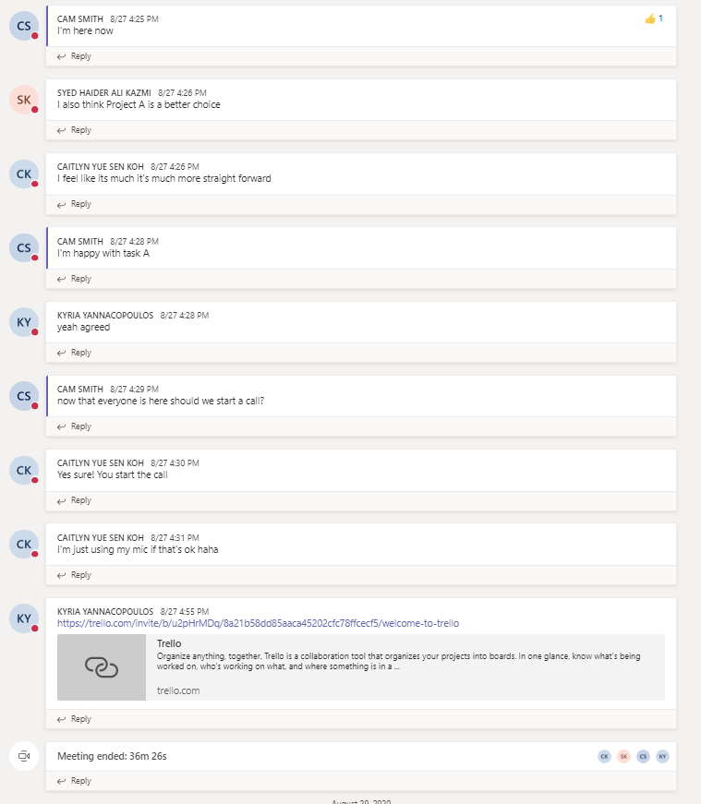
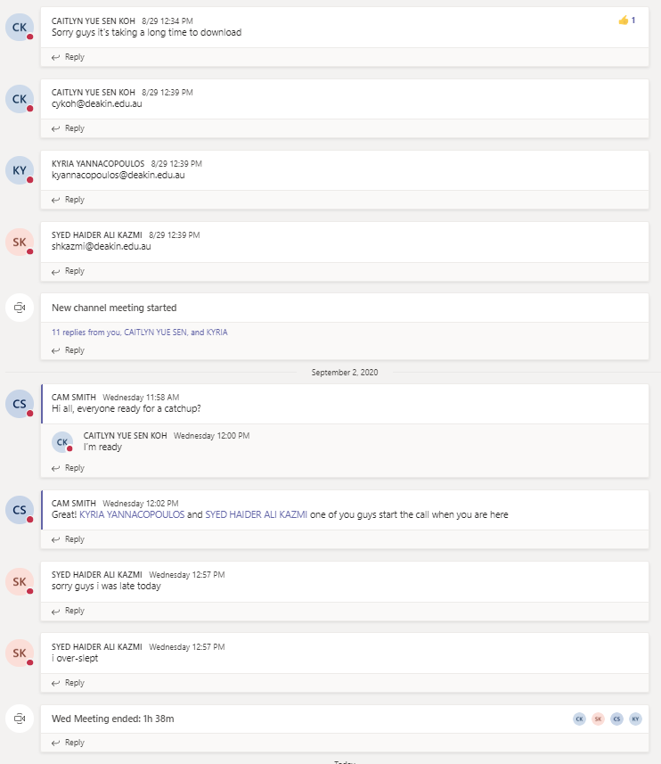
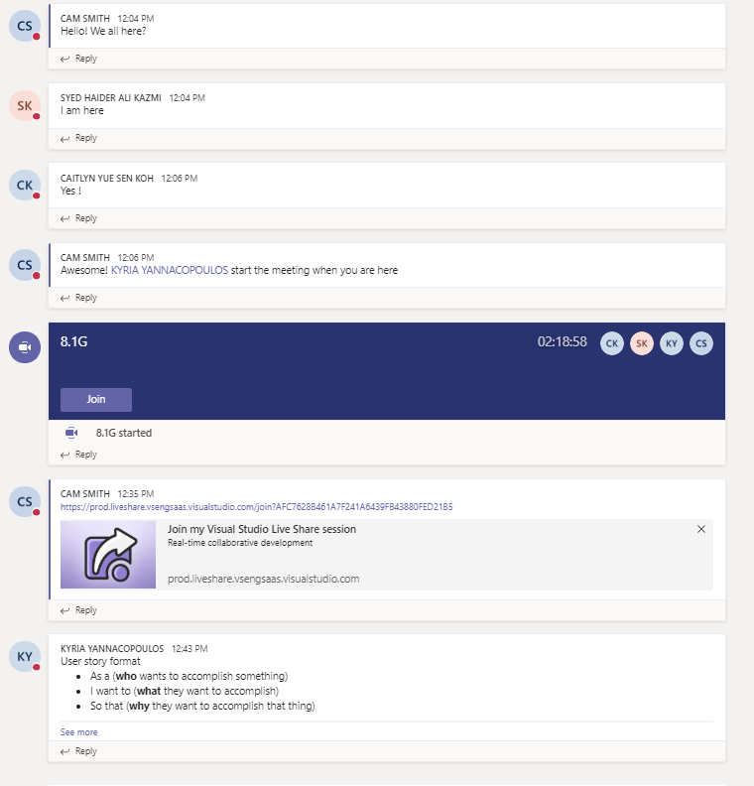
MS Teams COMMUNICATION

Slide 6
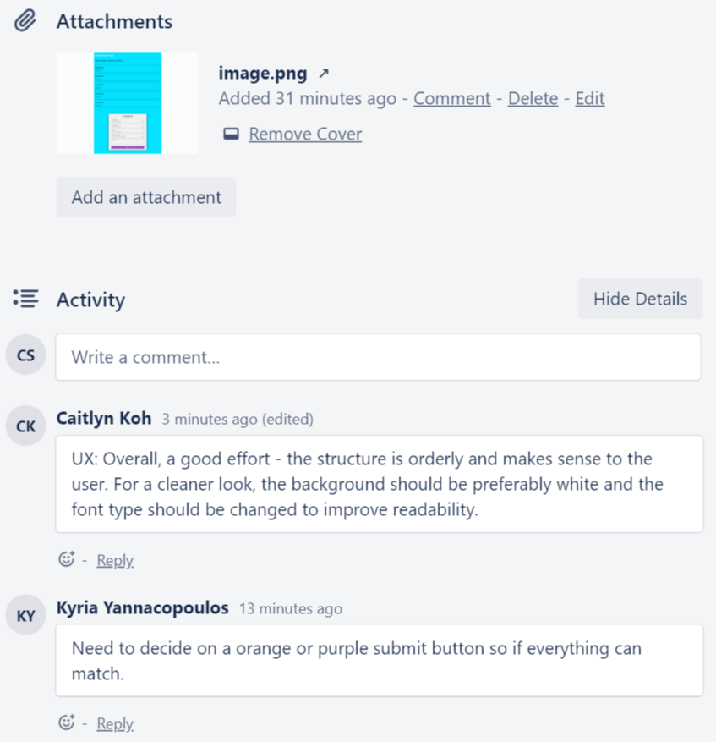
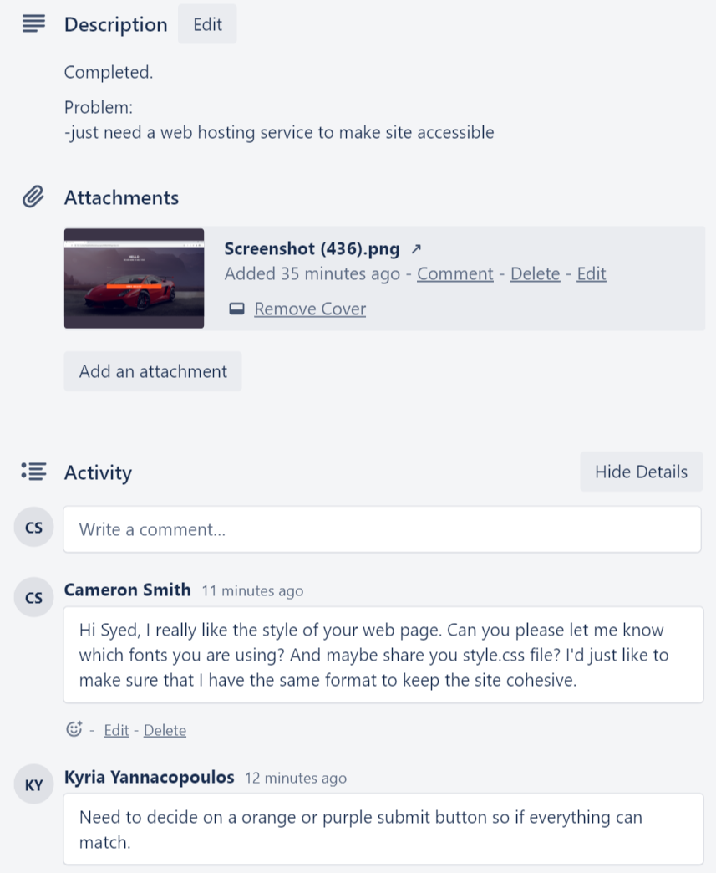
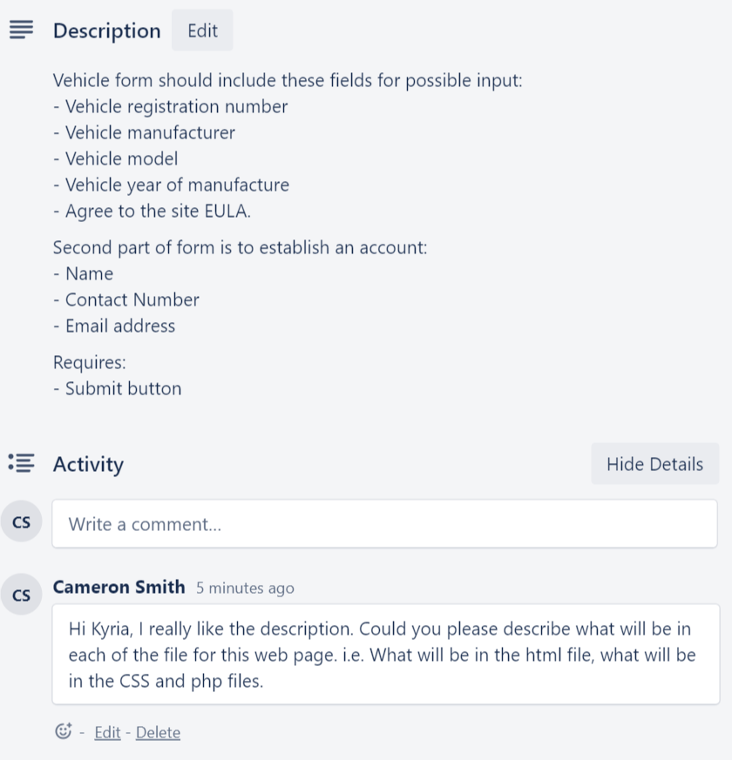
Trello COmmunication

Slide 7
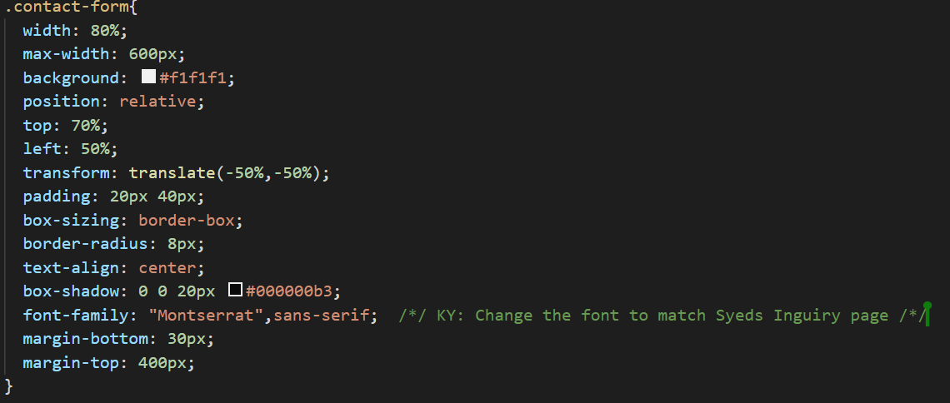
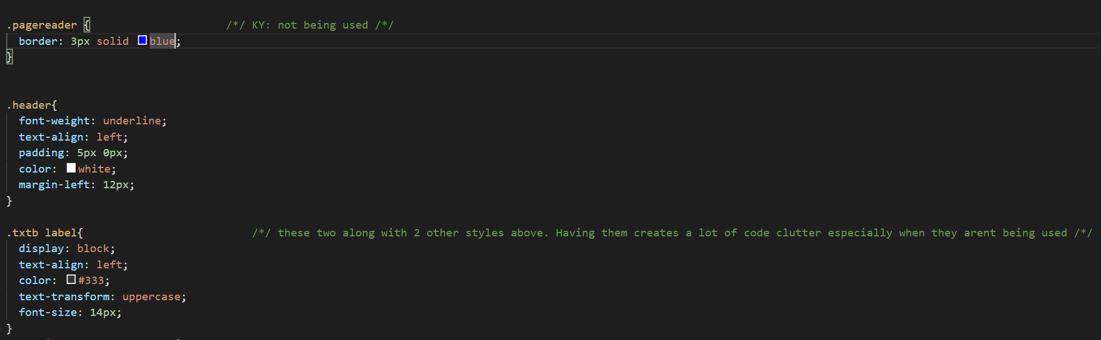
Visual Studio Code
Please see the comments in green, by other users.

Slide 8
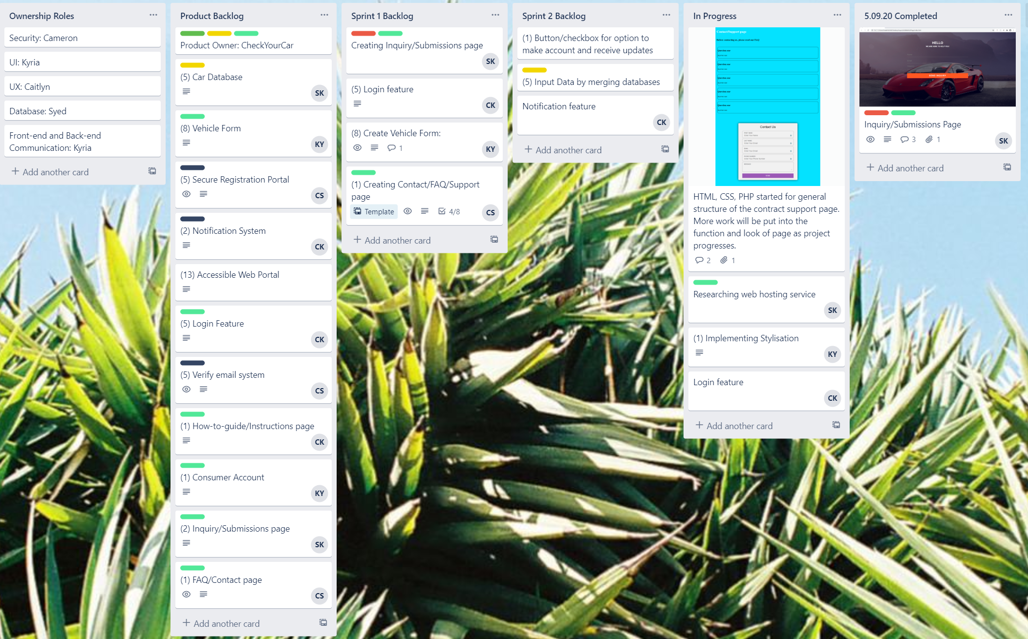
Details of your sprint planning on Trello including tasks and roles.
During the second meeting we allocated roles and responsibilities, which can be noted in our Trello board.

Slide 9
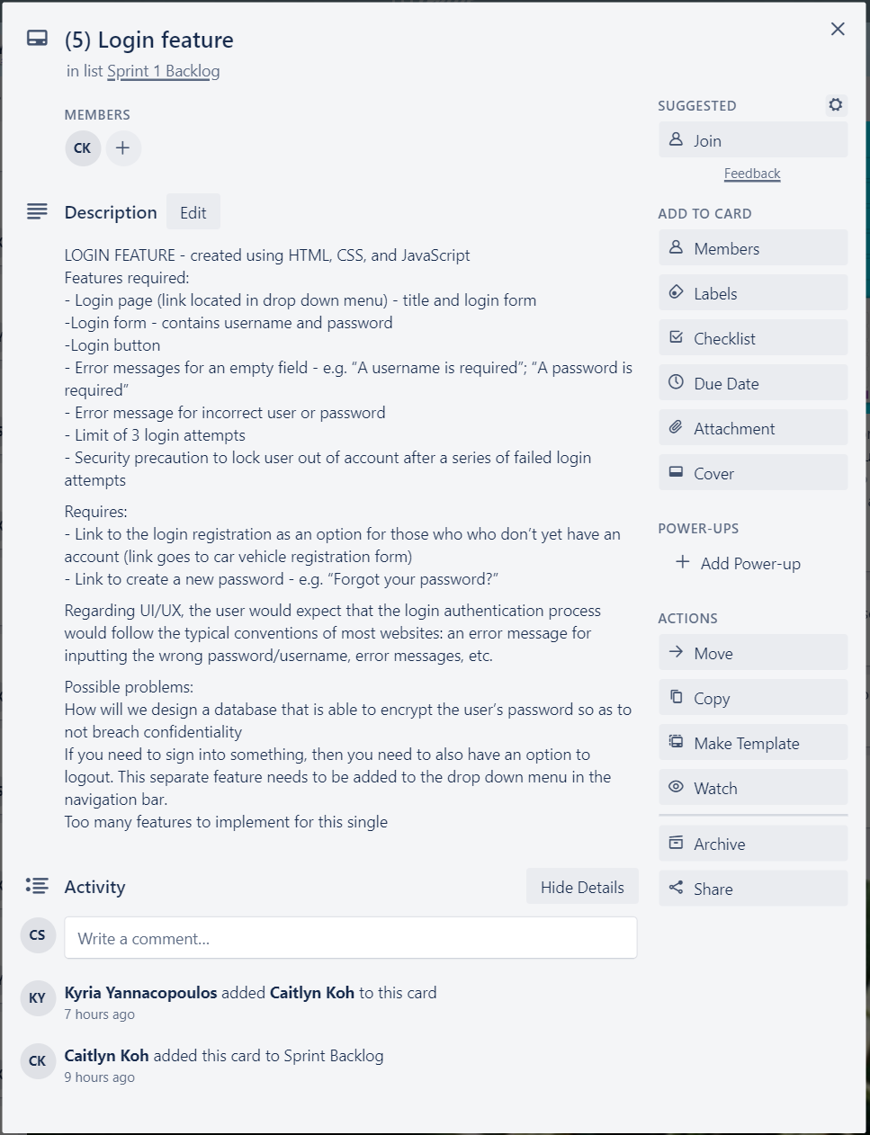
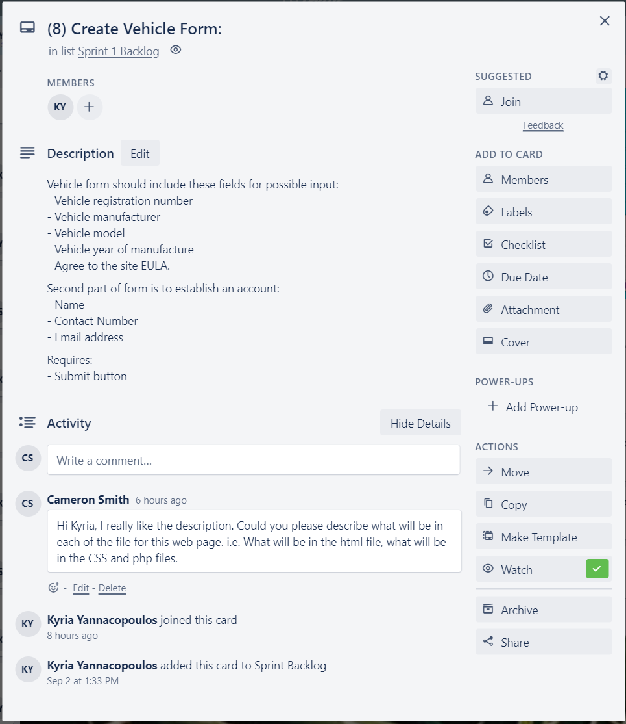
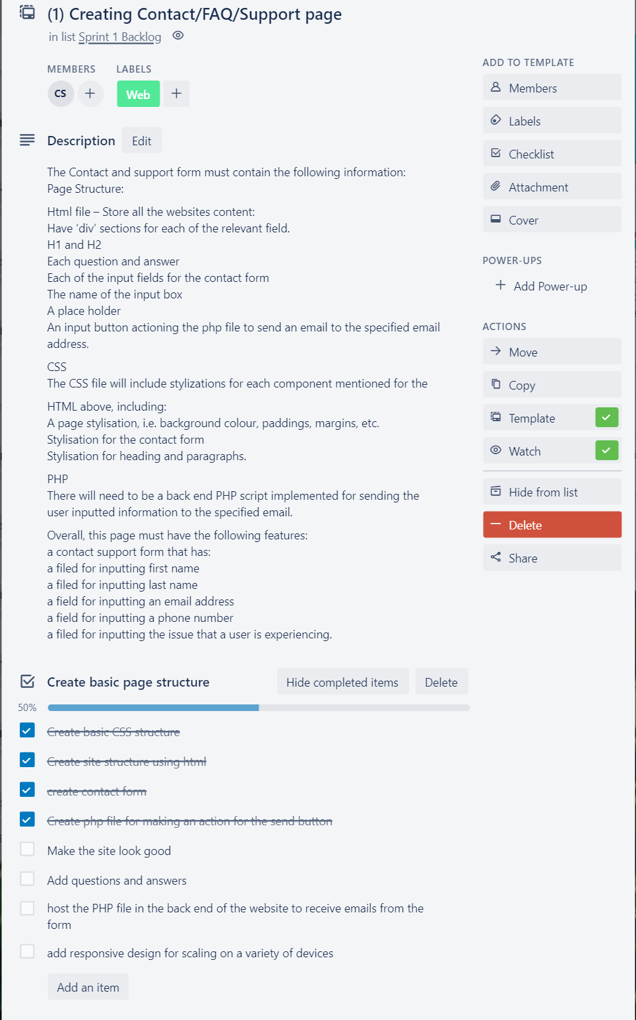
TRELLO TASKS

Slide 10
Ownership roles
Each team member has their own identified roles for the task which is as follows:
Security: Cameron
User Interface: Kyria
User Experience: Caitlyn
Database: Syed
Furthermore, roles specific to each of the responsibilities were assigned for sprint one, including:
Syed: Creating Inquiry Submission page
Kyria: Create Vehicle Form
Cameron: Contact form / FAQ / Support Page
Caitlyn: Login Feature

Slide 11
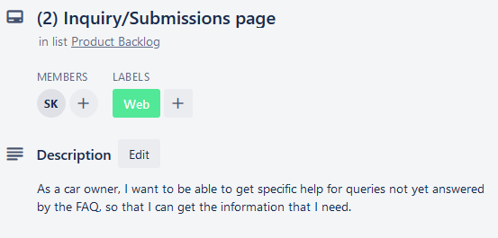
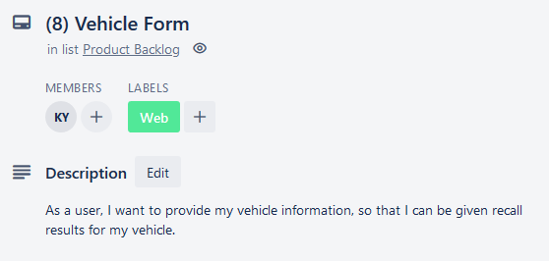
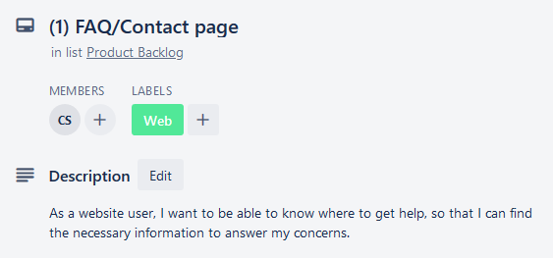
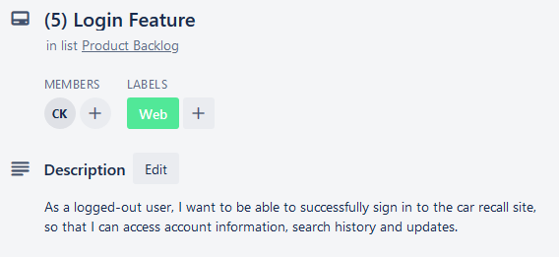
User Stories

Slide 12
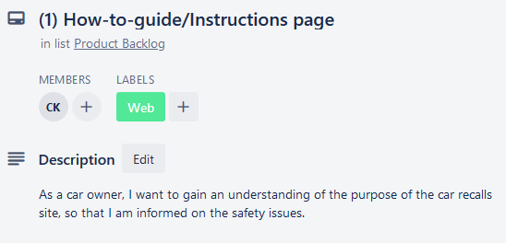
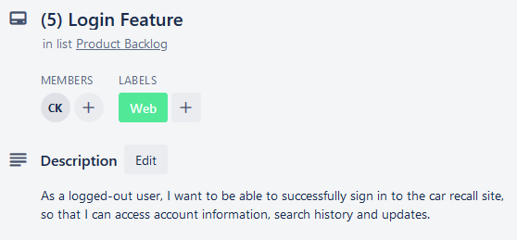
Story Points
Story Point (1)- Easiest to design and implement
Story Point (5)- more difficult for the many algorithms included also more time cosuming.

Slide 13
Future/Plan
The next sprint will involve the further development of the defined features that were implemented in sprint one. Furthermore, additional features will be discussed.
Additional features include:
The hosting of PHP on a webserver.
Refining the layout to ensure that the user interface looks.
Add information to the template, ensuring that the FAQ page fulfills its purpose.
Completing the Vehicle form
Completing the Login Feature

Slide 14
Link to presentation recording:
https://video.deakin.edu.au/media/t/1_7ggycmcv

